Slide 1
Verification of AHB to APB Bridge
By Bharath Tupaki and Vinod Sake
ECE 595 – Emulation and Functional Spec Verification

Slide 2
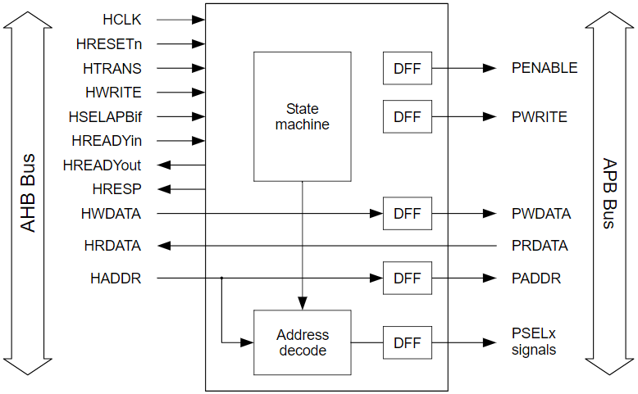
DUV Architecture

Slide 3
DUV Architecture (cont’d)
Two interfaces - AHB and APB
AHB Slave signals converted to APB Master signals
State Machine responsible for conversion
Address Decode logic selects appropriate slave
Bridge RTL borrowed from GitHub (https://github.com/RoaLogic/ahb3lite_apb_bridge)

Slide 4
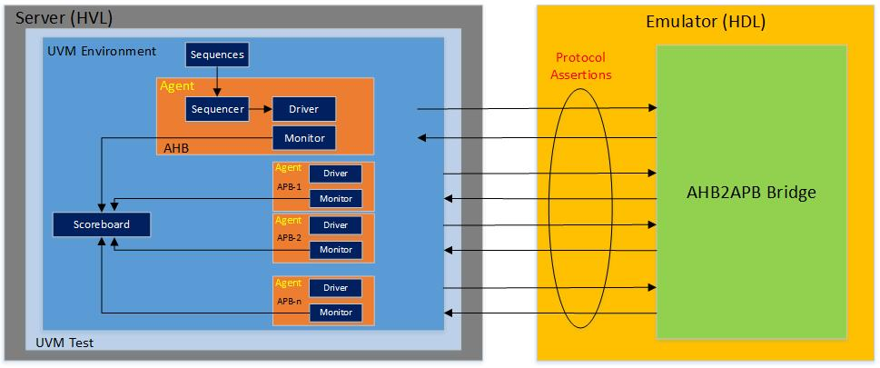
Verification Plan

Slide 5
Verification Plan (cont’d)
UVM verification environment
Assertion based checker
Constrained random verification
Coverage to track different transactions
Virtual sequences to imitate master and slave
Verify WRAP and INCR burst transfer
Verify NONSEQ transfer
Verify OKAY and ERROR response from slave

Slide 6
Emulation Approach
TBX Mode with UVM
UVM Driver and Monitor tasks made synthesizable
DUV synthesized, UVM testbench created
Coverage, assertions, veloce communication to be completed
Progress - 60%

Slide 7
Future Plans
Complete Veloce communication
Assertions to check basic transactions
Put in more hours and finish the work
Introduce multiple masters and slaves

Slide 8


